Slide 1
A Shell Written in C
Matt Beauvais and Jan Feyen

Slide 2
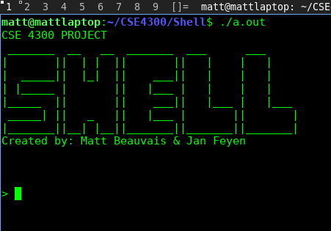
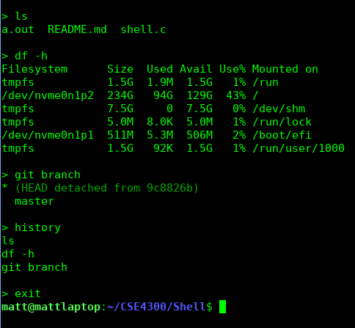
Premise
Program will continually prompt user for input
Shell will accept any commands in the users PATH
Bash commands
Any program in the current working directory
Some commands overwritten
history
Exit
Commands can accept arguments
ex. df -h
Commands can be placed inside a pipeline
ex. ls -l | sort | wc
Command will be executed and output will be shown

Slide 3
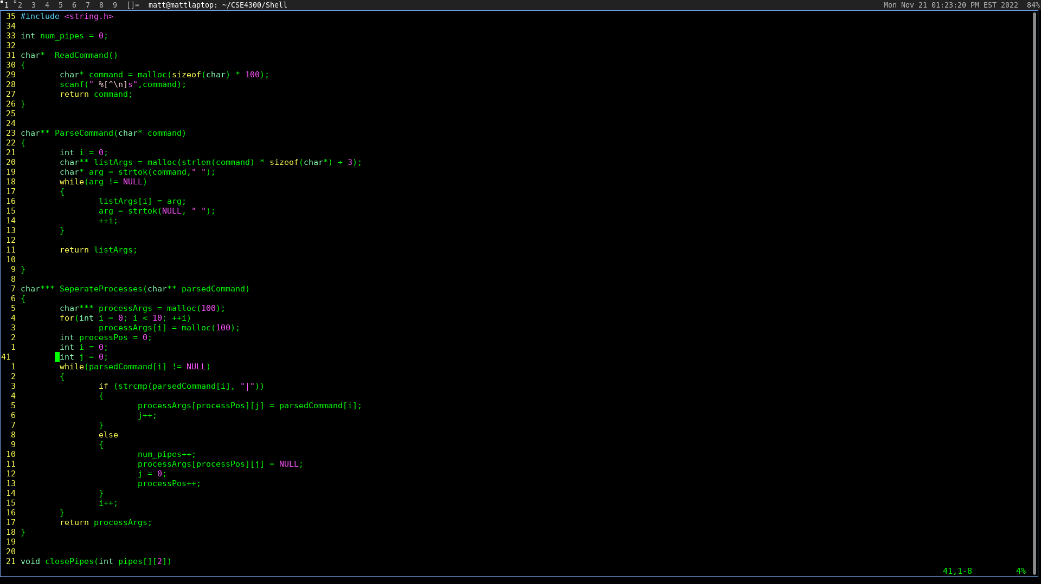
Reading and Parsing
Reads in command as a string “ls -l -h | sort”
Commands stored in history array
can be used later to print history
Separates by space (ParseCommand()):
returns {“ls”, “-l”, “-h”, “|”, “sort”}
Separates by processes (SeperateProcesses()):
returns { { “ls, “-l”, “-h” } , { “sort” } }
Keeps track of number of pipes to be used later (1)
Ultimately:
“ls -l -h | sort” -> { { “ls, “-l”, “-h” } , { “sort” } }
Commands and arguments can now be accessed dynamically
ie. ProcessArgs[1] = {“sort”}
useful for looping and executing without set number of commands

Slide 4
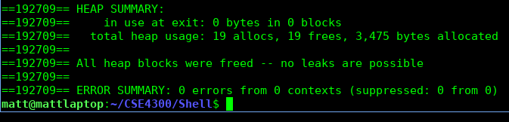
Allocating Space
In order to have space for each of the aforementioned structures, we must allocate space ex.
Allocates virtual memory from the heap
We use this to store commands, command history, and their parsed versions
Malloc():
Library function
Uses system calls mmap and sbrk
Can help us allocate pages of memory
Free():
Frees pages of previously allocated memory
Ensures no memory leaks upon exit

Slide 5
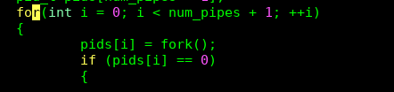
Forking New Processes
In order to execute the commands, a new process must be created
Fork()
Creates a new process, duplicating everything from the parent process
Allows us to fine-tune details (ie. set up pipes) before executing the program
Returns PID
Returns 0 to the child process, PID for the parent process
We store the PID’s in an array of pid_t data types
- If we did not do this, we would ultimately replace shell process after executing a command and never be able to return to it

Slide 6
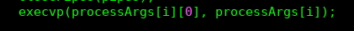
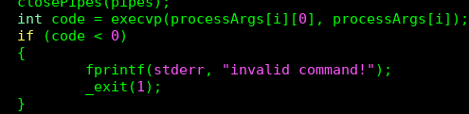
Executing Processes
Done inside of a child process (one of each command)
Will only return on error
Family of exec function (execl, execlp, execv, execvp)
We elected to use execvp
Easier to use with dynamic number of command arguments
Automatically searches within PATH
First exec argument is the name of the command, second exec argument are the arguments
Entire virtual address space is replaced
NOTE: all of the C exec functions end up calling the exec system call
Different formatting
Returns code upon error ( for example, if command does not exist)

Slide 7
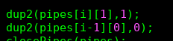
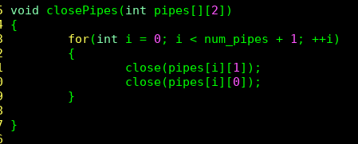
Pipes Between Processes
System call
Opens File Descriptors
Accepts array of size 2 (fd[2]) as argument
fd[0] for reading
fd[1] for writing
We create a 2d array for each pipe we need
If user types “command1 | command2 | command3”
We have an array of size 2 where each element is a 2d array
Dup2
Used in our project to redirect output or input
Example: dup2(pipe[1], 1) redirects stdout to the write end of “pipe”
Procesess within pipelines read input from the pipe before theirs in the pipeline array
STDIN is redirected to the read end of a pipe
Send stdout to the write end of a pipe to be read by the next process as input
Close
each process has their own “version” of the pipes
If we don’t close, then the commands won’t know when to stop receiving input

Slide 8
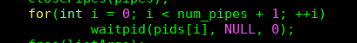
Wait
Q. How do we ensure that the shell does not ask for another input until execution is complete?
A. Waitpid() system call
Accepts child process PID as first argument
Other two are for status and options
Our program makes parent process (where the shell is running) wait on child processes to finish execution in the order they were created

